Slide 1
Flowers Shop
Web application using modern web development

Slide 2
Contents
Overview
Application Architecture
Tools and technologies
Screenshots

Slide 3
Overview
Purpose
Create a flowers shop store where:
Customers buy flowers electronically
Customers can visit and update their shopping cart
Administrators can perform CRUD operations to products

Slide 4
Architecture
1 Presentation Tier
2 Business Tier
3 Data Tier
Web pages interface using a browser
Web API’s to process user requests and data
Storage for data about products and users

Slide 5
Tools and Technologies
Frontend
ReactJS JS library
HTML5
Bootstrap 4 / CSS
Font Awesome
Backend
NodeJS (Development Server)
ASP.NET Core (Web API)
Database
Firebase
Database for shopping carts
User account storage and authentication services
MS SQL Server Express
For products management
Postman
Visual Studio Code

Slide 6
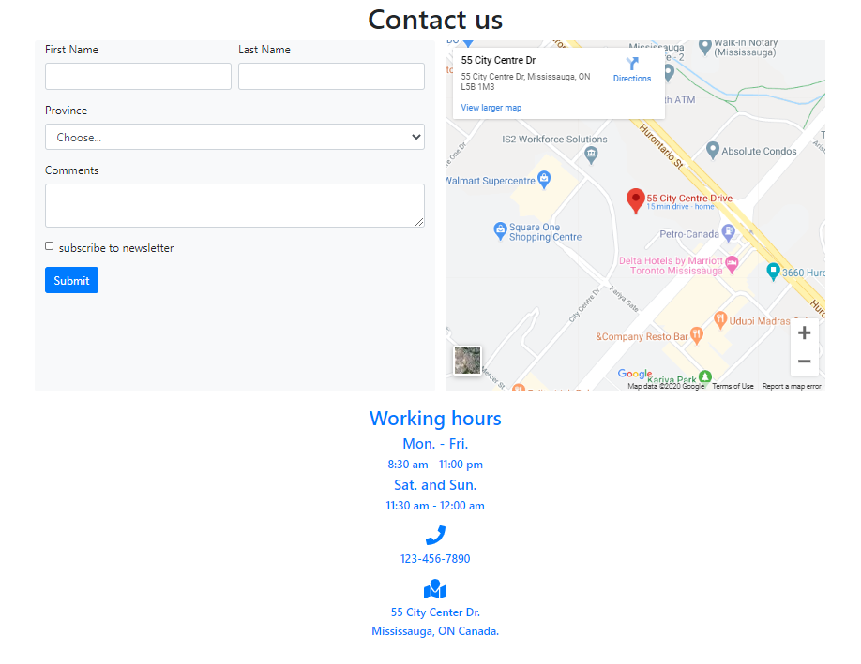
Screenshots
Contact us
Navigation bar
Body
Form
Map
Text

Slide 7
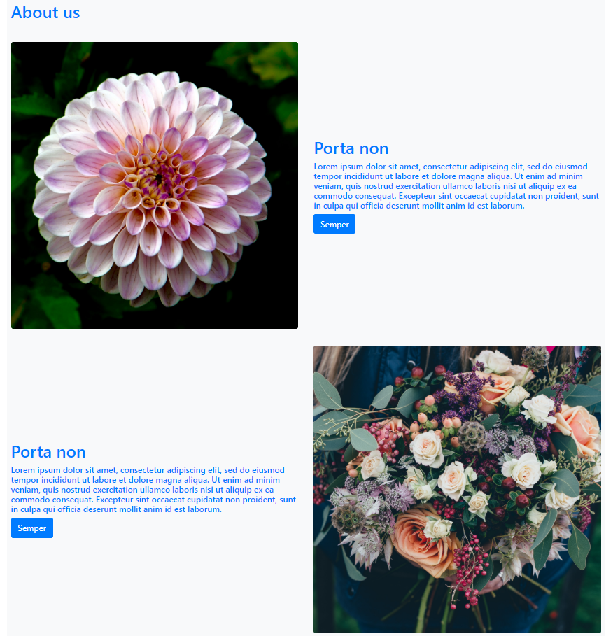
Screenshots
About us
Navigation bar
Body
Text
Picture
Card
Card
Card

Slide 8
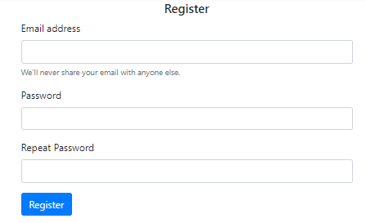
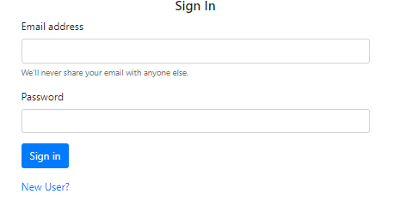
Screenshots
Login / Register

Slide 9
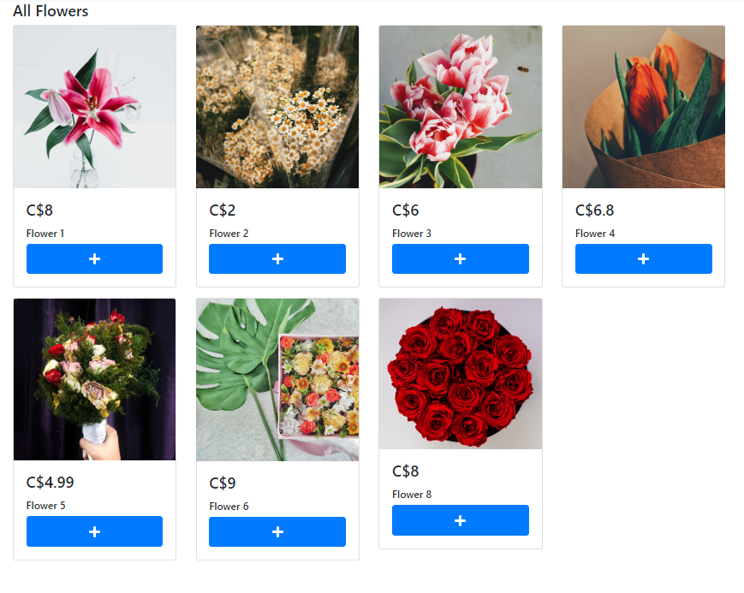
Screenshots
Home
Navigation bar
Body
Product1
Product2
Product3
+
+
+
Product4
Product5
Product6
+
+
+

Slide 10
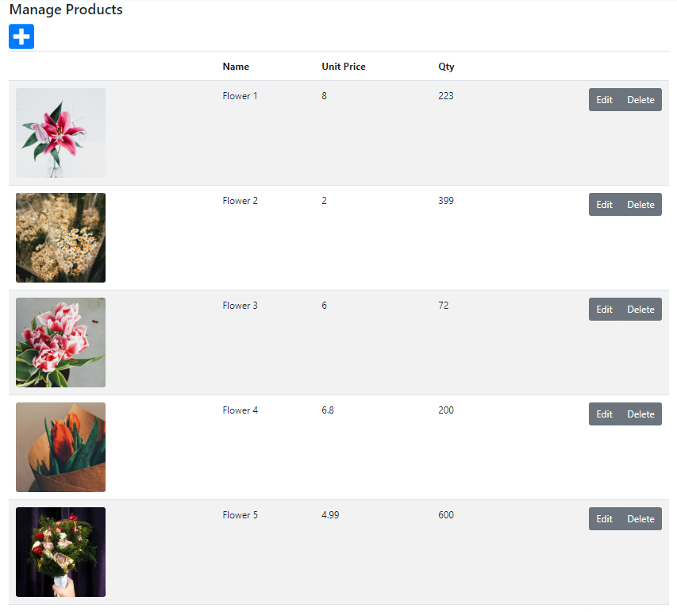
Screenshots
Products
Navigation bar
Body
+
name | price | picture |  | Controls
Prod 1 | price |  |  | Edit – Del
Prod 2 | price |  |  | Edit – Del
Prod 3 | price |  |  | Edit – Del

Slide 11
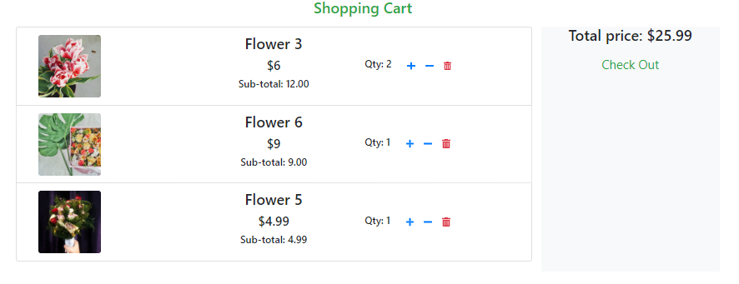
Screenshots
Cart
Navigation bar
Body
name | price | picture |  | Controls
Prod 1 | price |  |  | + - Del
Prod 2 | price |  |  | + - Del
Prod 3 | price |  |  | + - Del

Slide 12


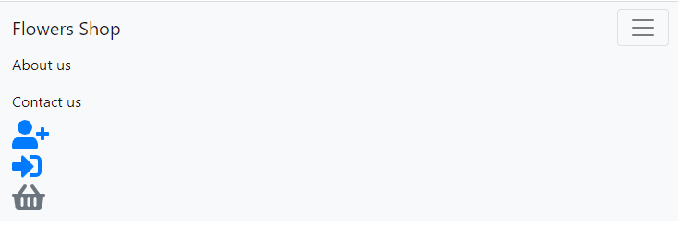
Screenshots
Navigation bar

Slide 13
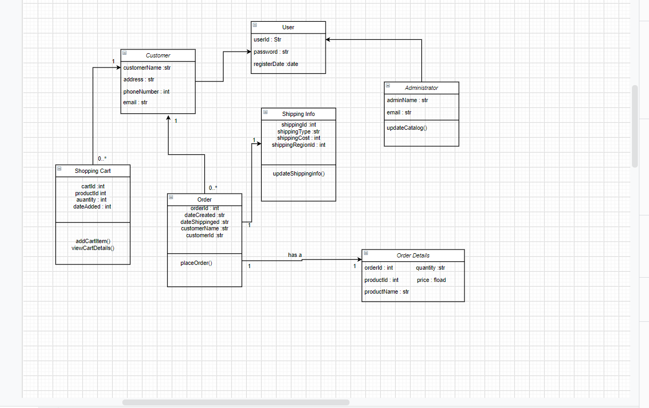
Relaytionship

